Slide 1

職場故事
Animaze
Notes:
https://unsplash.com/photos/gray-laptop-beside-teacup-and-bg-vATgbfp7oXA

Slide 2
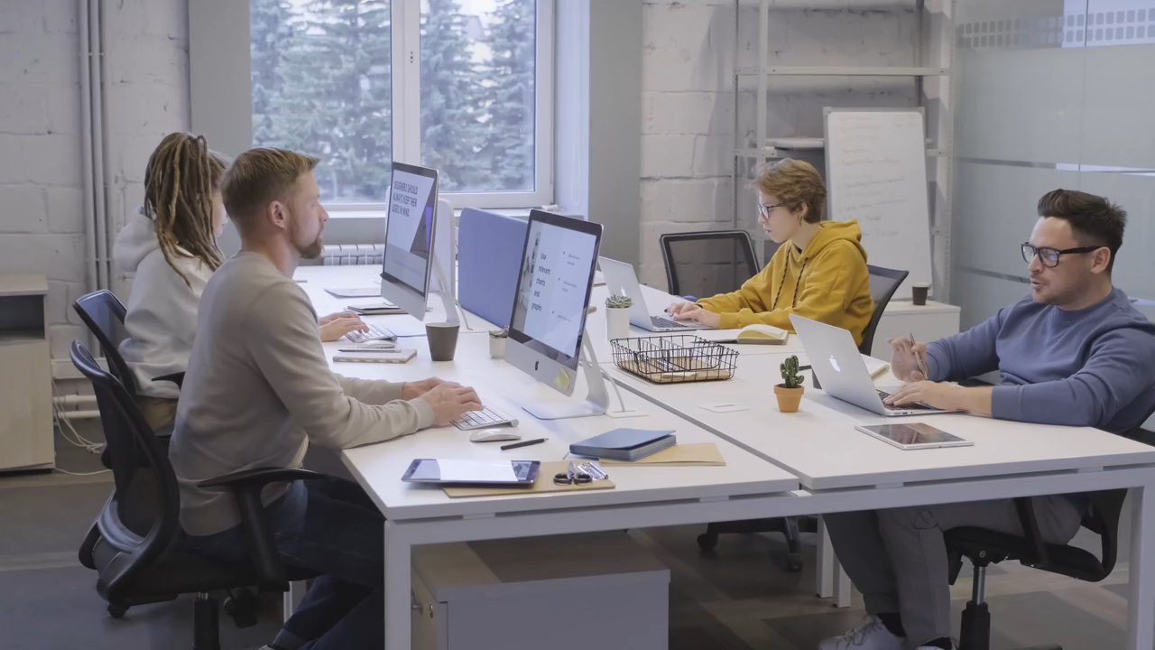
1.目標
Notes:
https://pixabay.com/videos/office-meeting-working-discussion-69952/

Slide 3
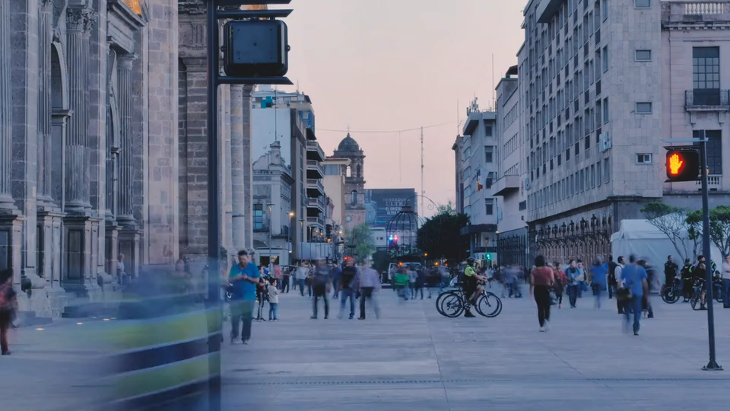
2.阻礙
Notes:
https://pixabay.com/videos/street-crosswalk-people-walking-173333/

Slide 4

3.努力
Notes:
https://pixabay.com/videos/smile-face-girl-young-happy-woman-43631/

Slide 5
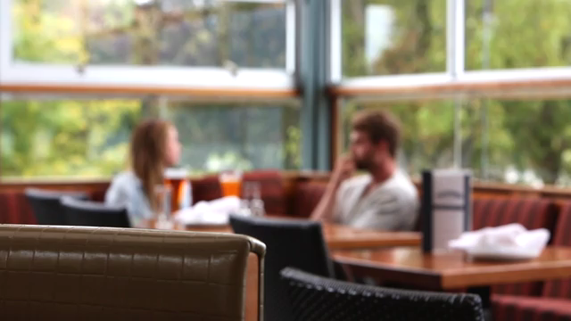
4.結果
Notes:
https://pixabay.com/videos/restaurant-couple-bokeh-blur-6409/

Slide 6
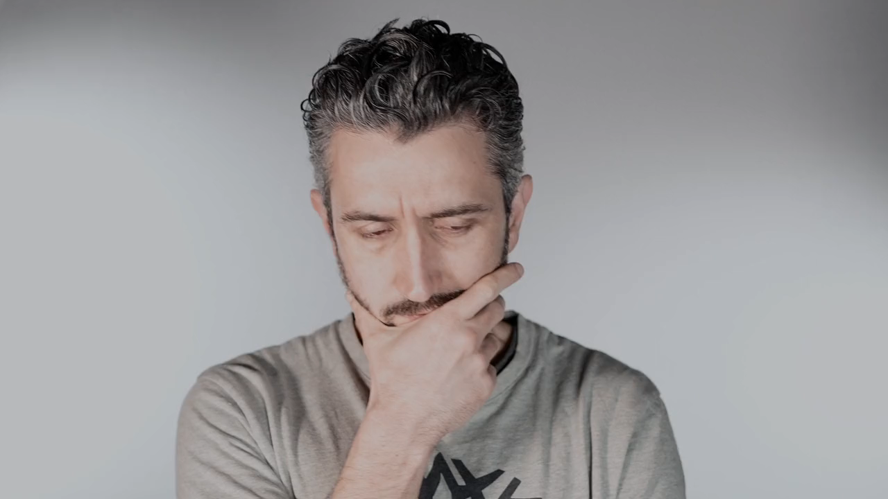
5.意外
Notes:
https://pixabay.com/videos/man-think-beard-thoughtful-203251/

Slide 7
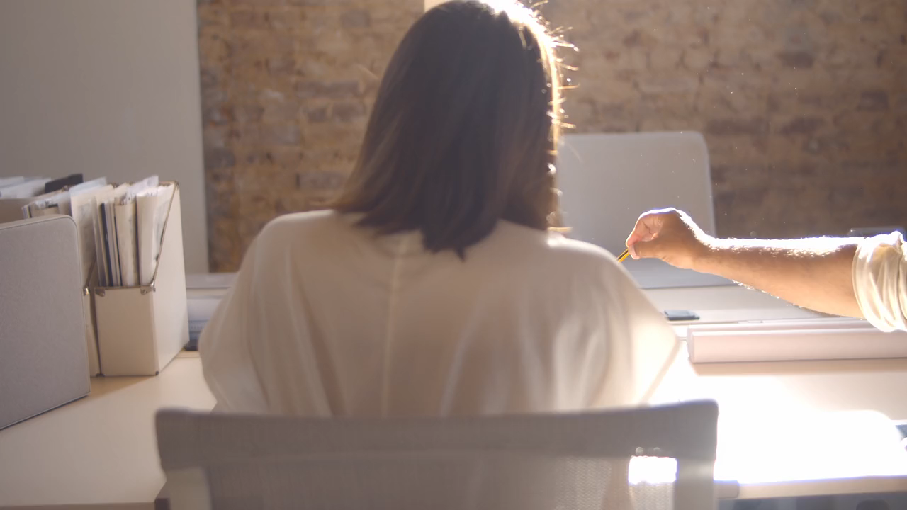
6.轉彎
Notes:
https://pixabay.com/videos/team-office-worrk-meeting-201511/

Slide 8
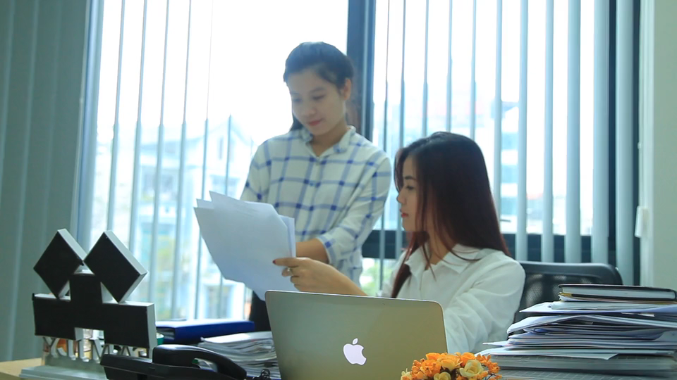
7.結局
Notes:
https://pixabay.com/videos/girl-office-w-computer-work-27096/

